Slide 1
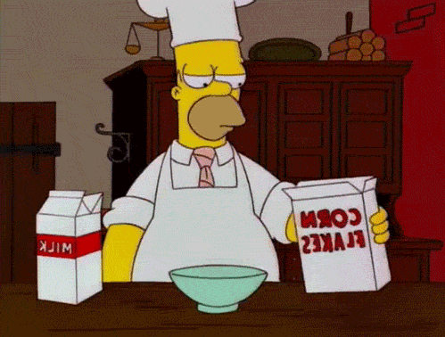
You will demonstrate your methodological findings and your early stage prototypes during the next Interaction Prototyping session. Prepare a 10 minute presentation on your approach and the corresponding results, covering all the work done in the first iteration.
Don’t necessarily proceed task-by-task, but rather tell a methodological story (why you chose certain methods, techniques or tools). Demonstrate the work in progress and formulate questions to debate with the experts in the plenary during a 10 minute discussion.

Slide 2
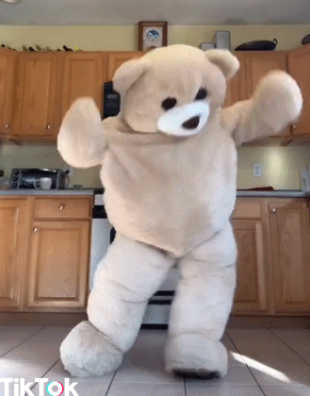
Team
Pacman
- Iteration 1 -

Slide 3
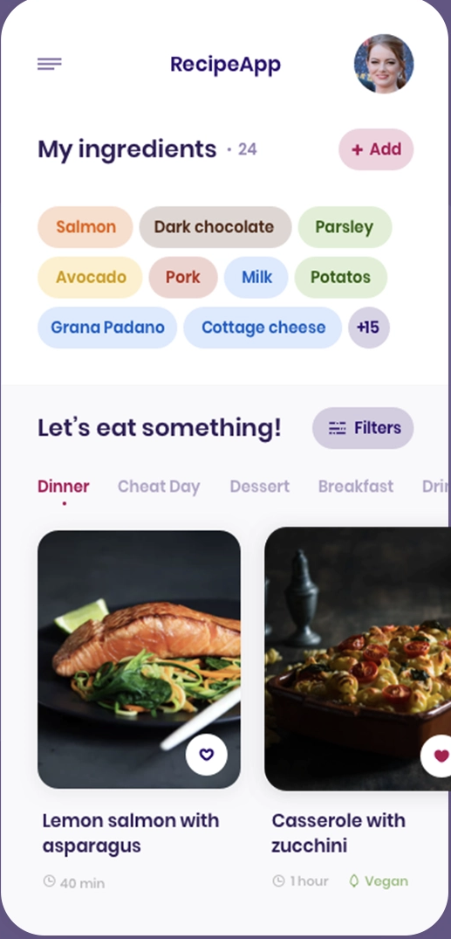
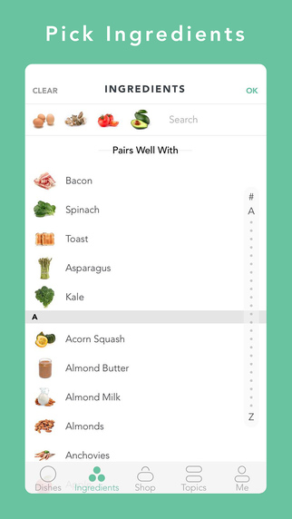
FOODIYO
- discover new recipes -
The goal of the app is for people to discover new recipes with the ingredients they have already at home.
App designed for everybody, but more focused on the youth.
Possibility to scan your own fridge, select different food/diet types or the duration of meal.
https://www.geekwire.com/2015/app-of-the-week-handpick-finds-recipes-for-the-ingredients-in-your-fridge/
https://dribbble.com/shots/7170152-Smart-Recipes

Slide 4
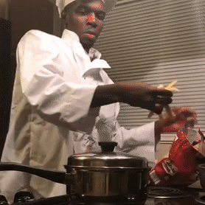
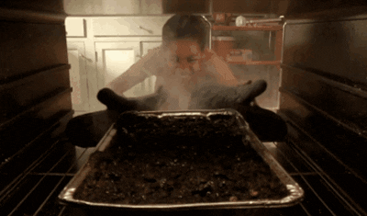
Interviews
"I always have a type of food in mind but cannot find the right recipe!"
"Sometimes I am worried about not having all the ingredients at home!"
"I often buy ingredients when there are special offers & check what to prepare with it afterwards!"
"I am disappointed when a dish did not turn out well!"
"I am annoyed when I'm struggling to find a recipe!"
Notes:
Interviews - most importants statements

Slide 5
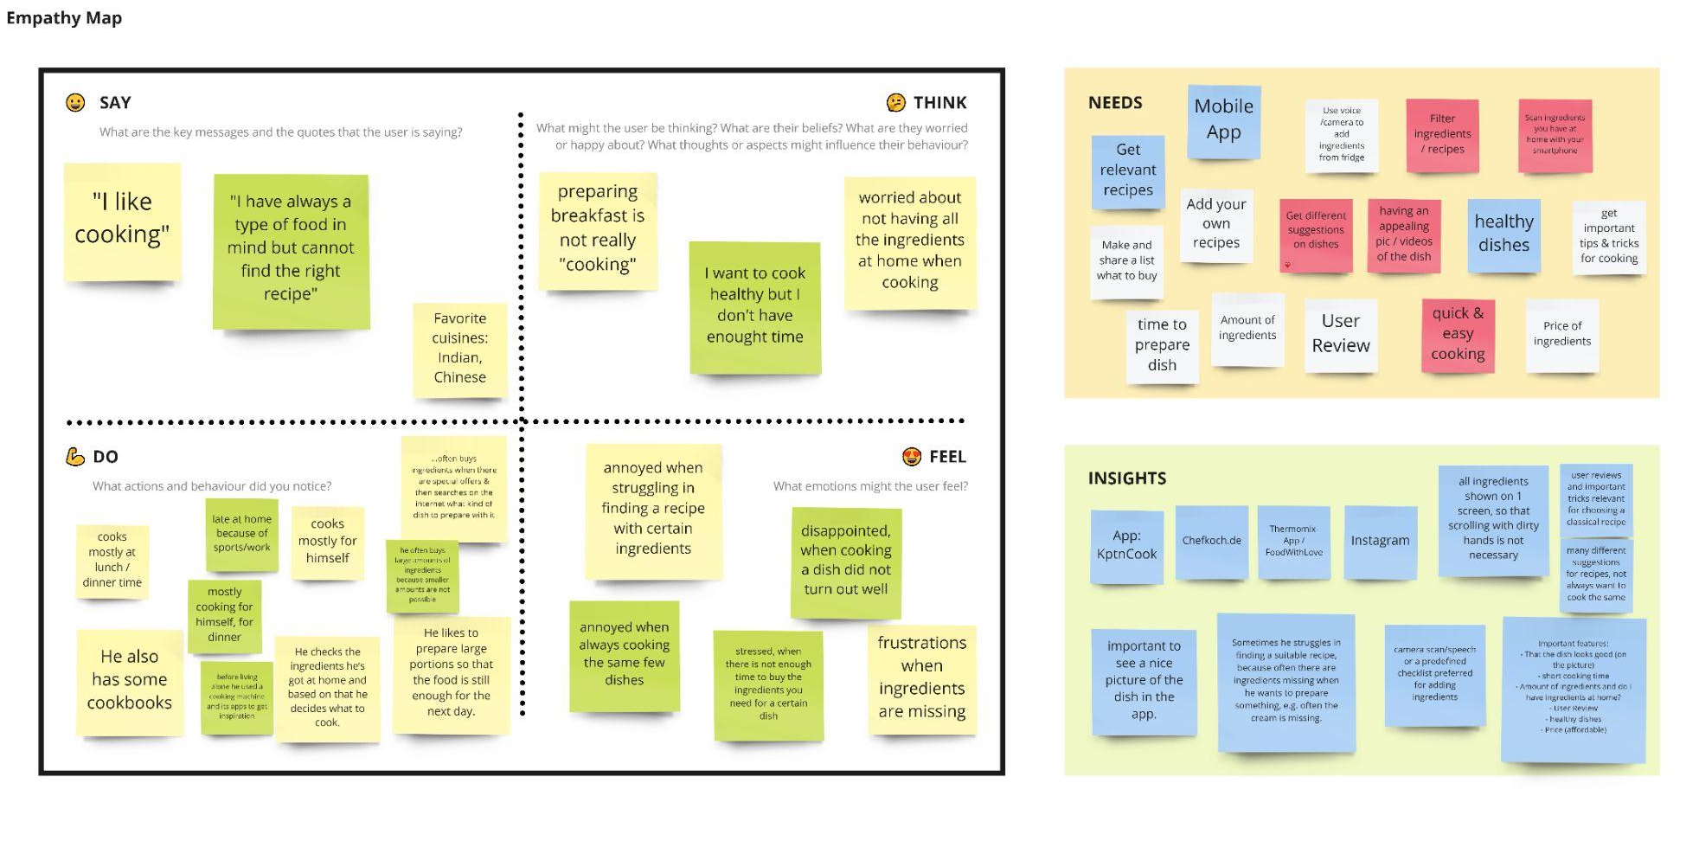
Notes:
An Empathy Map is just one tool that can help you empathise and synthesise your observations from the research phase, and draw out unexpected insights about your user’s needs.
An Empathy Map allows us to sum up our learning from engagements with people in the field of design research. The map provides four major areas in which to focus our attention on, thus providing an overview of a person’s experience. Empathy maps are also great as a background for the construction of the personas that you would often want to create later.

Slide 6
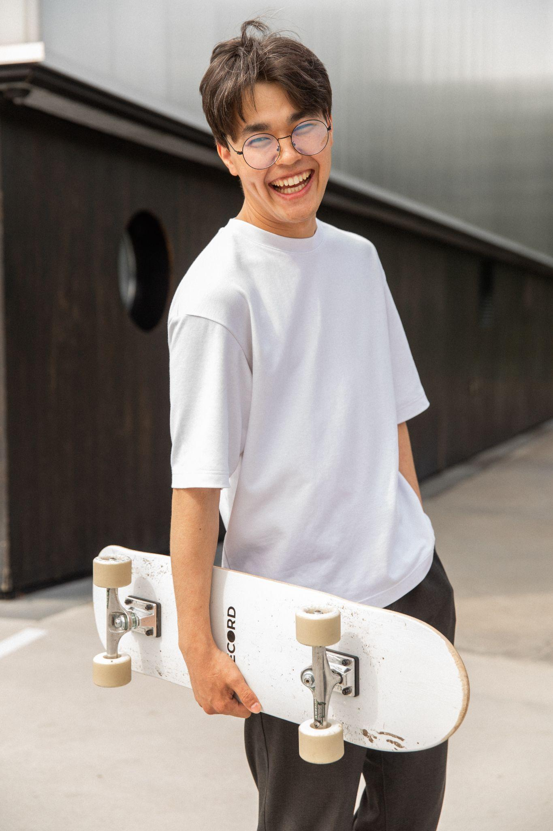
Daniel PERSONA
AGE: 24 OCCUPATION: Working Student STATUS: Single LOCATION: Munich EDUCATION: Informatics M.Sc. HOBBIES: Skateboard, . Tennis, Soccer
NEEDS - Get relevant recipes based on ingredients he’s chooses - Quick & easy cooking - Get suggestions on dishes - Healthy dishes - Appealing pictures of dish
GOALS - Having fun while cooking - Improve cooking skills - Cook for family & friends
FEARS - No clue how & what to cook - Worried about not having all the ingredients at home
“I cook because it’s fun to get hands-on with food and experiment with flavors”
https://www.pexels.com/de-de/foto/freudiger-ethnischer-mannlicher-teenager-der-skateboard-tragt-und-nach-dem-training-im-park-lacht-5384429/
Notes:
I think one persona is enough for our presentation

Slide 7
How might we support students in discovering new recipes to prepare great dishes?
Notes:
Our HMW question

Slide 8
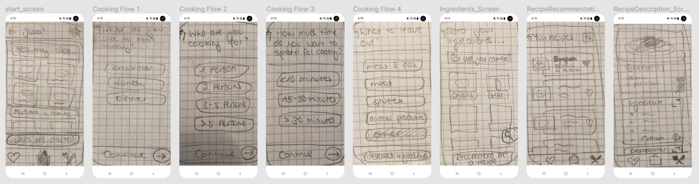
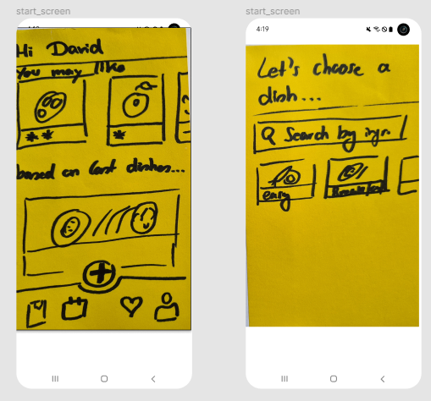
Sketches

Slide 9
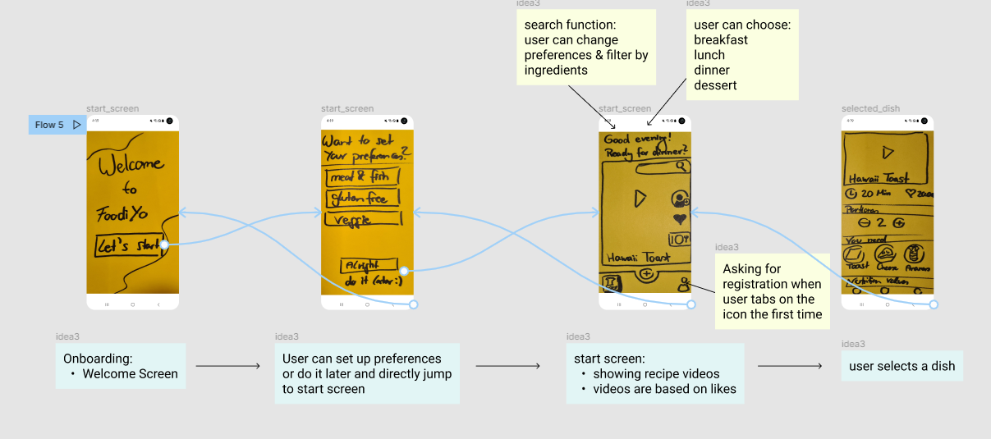
Sketches

Slide 10
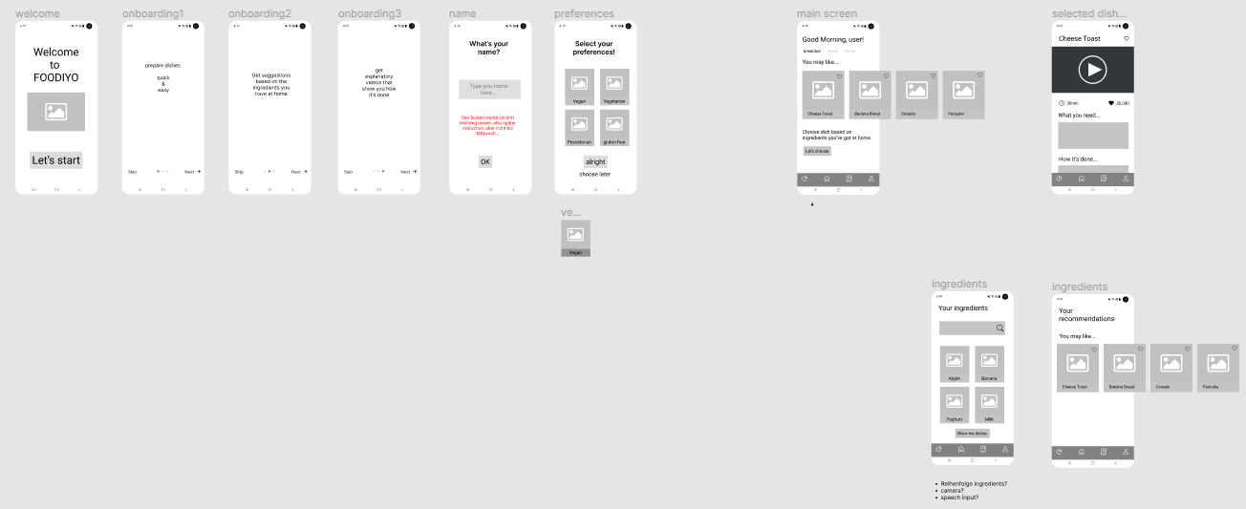
Low-Fidelity Prototype

Slide 11
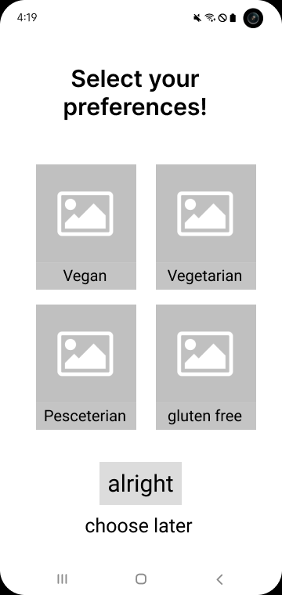
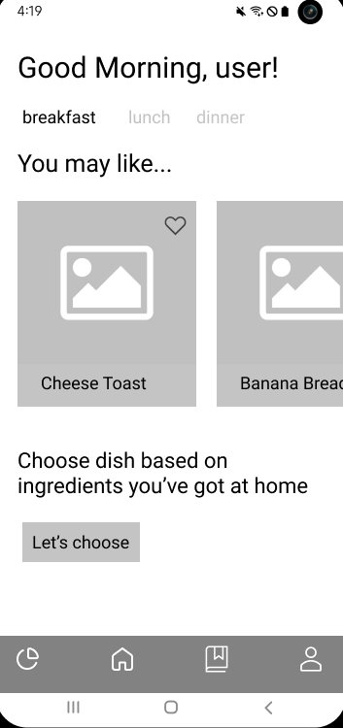
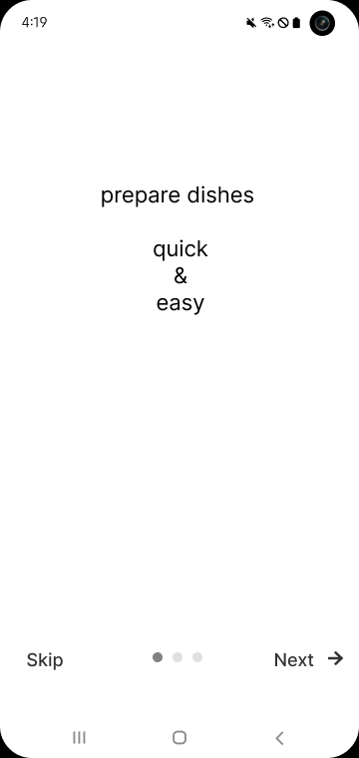
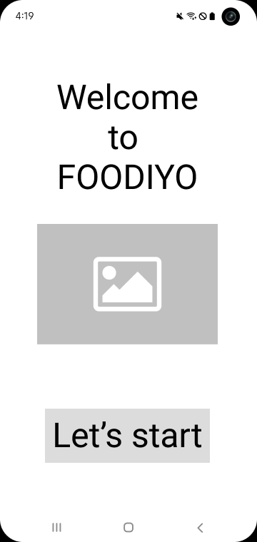
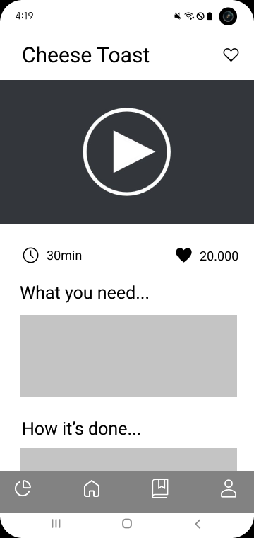
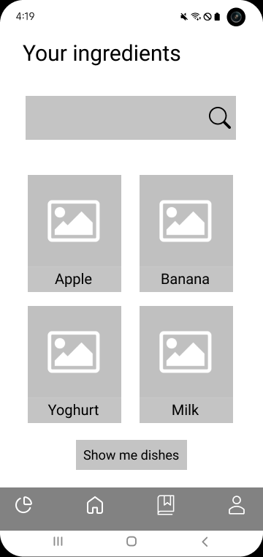
User Flow
selects individual preferences
receives recipe suggestions on the home screen
swipes through onboarding flow
User enters the app
starts selecting the ingredients
chooses preferred recipe
gets recipe recommendations

Slide 12
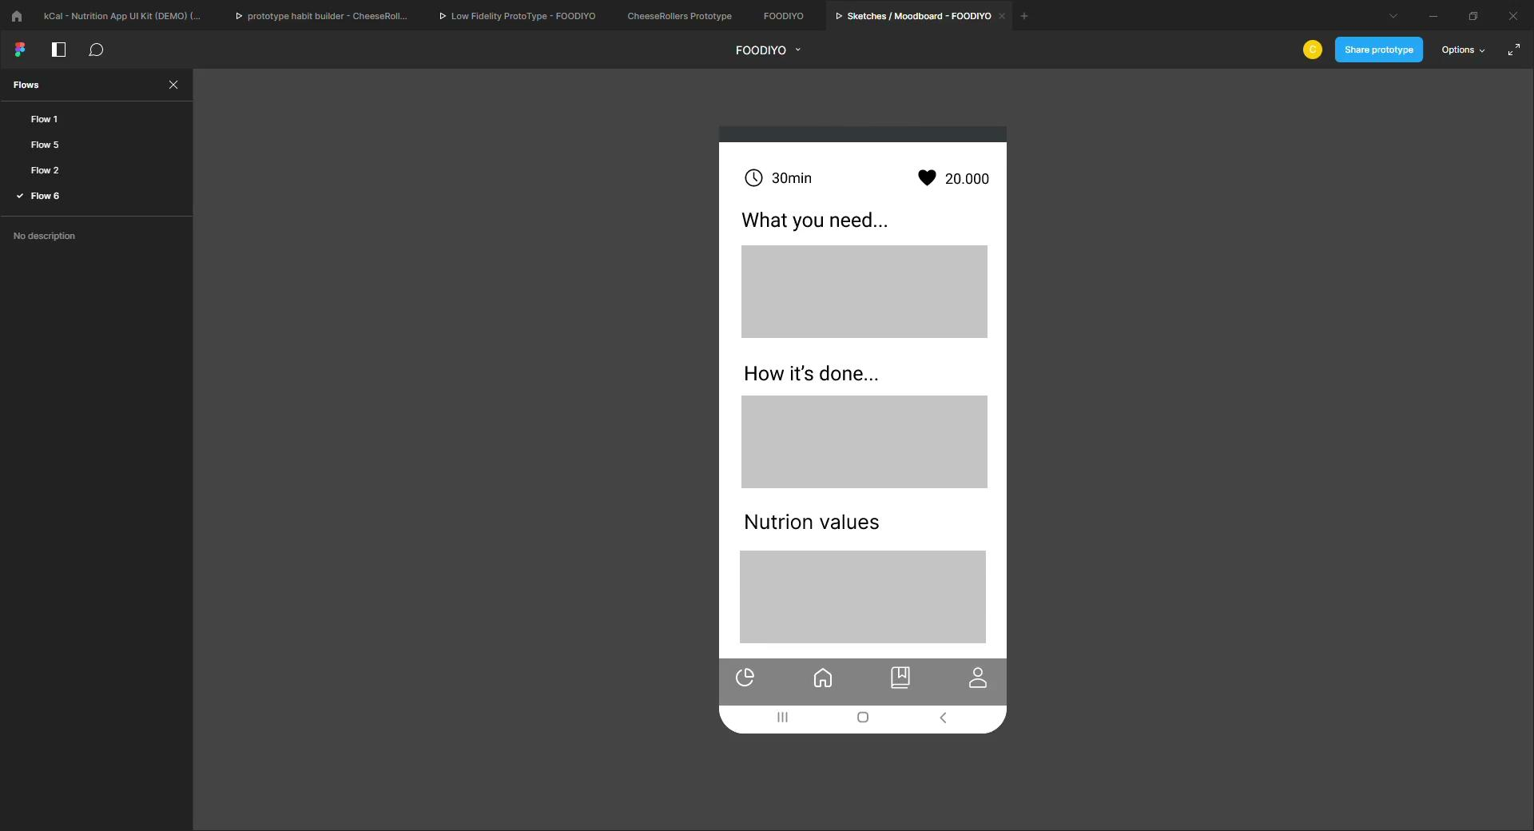
Prototype
https://www.figma.com/proto/h84h7g8BAsLOiNw8uyKVOt/FOODIYO?page-id=0%3A1&node-id=51%3A1366&starting-point-node-id=51%3A263&scaling=min-zoom&show-proto-sidebar=1
Notes:
Here: live presenation of prototype?

Slide 13
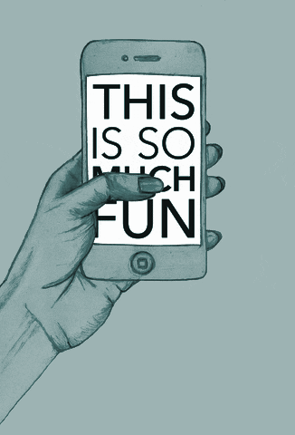
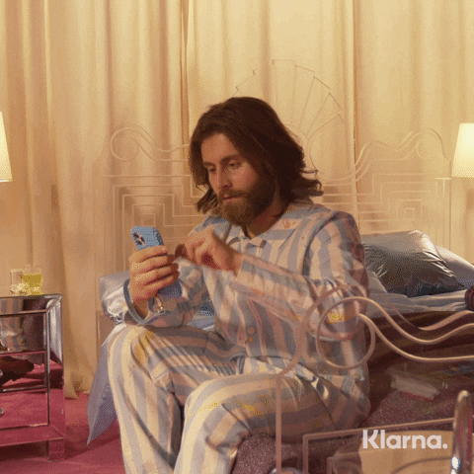
User Testing
“I would like to see more colors and a nicer UI design.”
“I do not like Cheese Toast!”
“I would prefer an earlier selection of whether to receive a recommended recipe or choose a dish freely!”
"The App does not know what kind of ingredients I have at home, but is suggesting banana bread…?"
“More detailed text input instead of free spaces would be helpful”
https://giphy.com/gifs/klarna-reaction-reactions-tap-xvqIOHfQvth5NeoT0Y
https://giphy.com/gifs/transparent-63I6FXZTXks2A
Notes:
https://giphy.com/gifs/klarna-reaction-reactions-tap-xvqIOHfQvth5NeoT0Y
https://giphy.com/gifs/transparent-63I6FXZTXks2A

Slide 14
Conclusions...
→ revision of user flow regarding recipe recommendation based on ingredient selection
→ more appealing and colorful design
→ detailed text input, as well as pictures / videos
→ further development of implemented features

Slide 15
Needs to be done…
…formulate questions to debate with the experts in the plenary during a 10 minute discussion.
not sure about the camera integration / barcode scan?
not sure about creating a database for recipes…?
not sure about current user flow…?
how many different user flows should be fully implemented?

